Slide 3
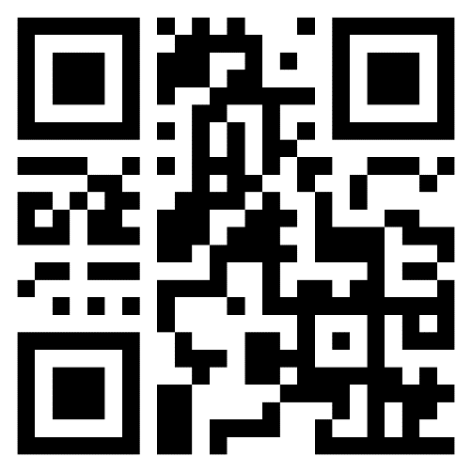
WACUBO 2025 CONFERENCE
CHECK-IN POINT
Point your phone’s camera at the QR code (also located on the backside of your badge)
Or navigate to https://wacubo.cnf.io
Tap the session matching this room

